Slide 1
Software Engineering
Wei-Min Wu（吴为民）
School of Petroleum
China University of Petroleum - Beijing at Karamay
Fall, 2025

Slide 2
Chap. 4 Requirements engineering
Topics covered
4.1 Functional and non-functional requirements功能和非功能需求
4.2 Requirements engineering processes 需求工程过程
4.3 Requirements elicitation 需求抽取
4.4 Requirements specification 需求规格说明
4.5 Requirements validation 需求确认
4.6 Requirements change 需求变更

Slide 3
Chap. 4 Requirements engineering
Requirements engineering 需求工程
The process of finding out, analyzing, documenting and checking the services the customer requires from a system, and constraints under which it operates and is developed. RE = 所需服务 + 约束
The term “requirement” is not used consistently in the software industry. 术语“需求”用法不一
In some cases, a requirement is simply a high-level, abstract statement of a service that a system should provide or a constraint on a system. 有时：高级抽象陈述
At the other extreme, it is a detailed, formal definition of a system function. 另一个极端：详细、正式定义

Slide 4
Chap. 4 Requirements engineering
Types of requirement
Requirements is thus distinguished between high-level abstract requirements and detailed description of what should do, as: 因而分为
User requirements 用户需求
Statements, in natural language plus diagrams, of what services the system is expected to provide to system users and the constraints under which it must operate.
System requirements 系统需求
More detailed descriptions of the system’s functions, services, and operational constraints. The system requirements document should define exactly what is to be implemented. It may be part of the contract between the system buyer and the developers.

Slide 5
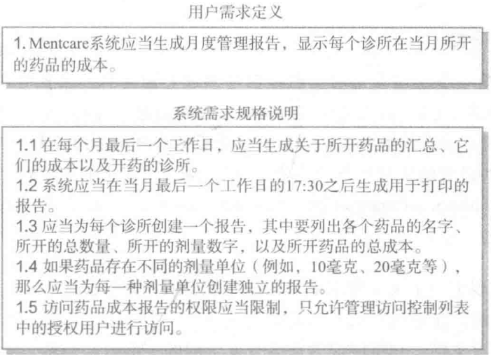
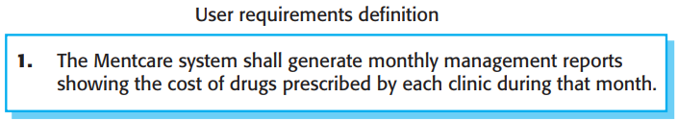
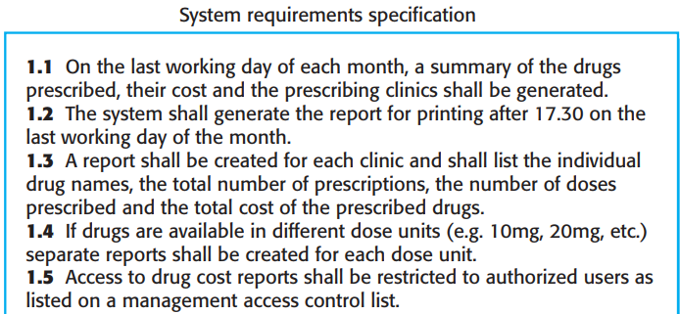
Chap. 4 Requirements engineering
User and system requirements 示例

Slide 6
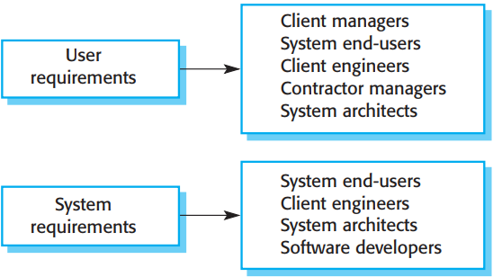
Chap. 4 Requirements engineering
Readers of different types of requirements specification 不同需求规格类型的读者
• The readers of the user requirements are not usually concerned with how the system will be implemented; The readers of the system requirements need to know more precisely what the system will do.

Slide 7
Chap. 4 Requirements engineering
System stakeholders 系统干系人
Any person who is affected by the system in some way and so who has a legitimate interest. 受系统影响、有合法利益的任何人
Stakeholders range from end-users of a system through managers to external stakeholders such as regulators, who certify the acceptability of the system. 范围广：最终用户、经理、外部干系人

Slide 8
Chap. 4 Requirements engineering
Stakeholders in the Mentcare system 示例
Patients whose information is recorded in the system and relatives of these patients.
Doctors who are responsible for assessing and treating patients.
Nurses who coordinate the consultations with doctors and administer some treatments.
Medical receptionists who manage patients’ appointments.
IT staff who are responsible for installing and maintaining the system.
A medical ethics manager who must ensure that the system meets current ethical guidelines for patient care.
Health care managers who obtain management information from the system.
Medical records staff who are responsible for ensuring that system information can be maintained and preserved, and that record keeping procedures have been properly implemented.

Slide 9
Chap. 4 Requirements engineering
4.1 Functional and non-functional requirements
Functional requirements 功能需求
Statements of services the system should provide, how the system should react to particular inputs, and how the system should behave in particular situations.
May also explicitly state what the system should not do.
Non-functional requirements 非功能需求
Constraints on the services or functions offered by the system such as timing constraints, constraints on the development process, standards, etc.
Often apply to the system as a whole rather than individual system features or services.
In reality 现实情况
The distinction between them is not clear.

Slide 10
Chap. 4 Requirements engineering
Functional requirements
Describe what the system should do. 描述做什么
Depend on the type of software, the expected users, and the general approach taken when writing requirements. 依赖软件类型、用户、编写方法
When expressed as user requirements, 用户需求
Functional requirements should be written in natural language so that users and managers understand them.
Functional system requirements 系统需求
Expand the user requirements and are written for system developers. They should describe the system functions, their inputs and outputs, and exceptions in detail.

Slide 11
Chap. 4 Requirements engineering
Mentcare system: functional requirements Mentcare系统的功能需求
1. A user shall be able to search the appointments lists for all clinics.
2. The system shall generate each day, for each clinic, a list of patients who are expected to attend appointments that day.
3. Each staff member using the system shall be uniquely identified by his or her 8-digit employee number.
The requirements show that functional requirements may be written at different levels of detail (contrast requirements 1 and 3). 功能需求可用不同细节级别来编写

Slide 12
Chap. 4 Requirements engineering
Requirements imprecision 需求不精确性
Imprecision in the requirements specification can lead to disputes. 需求规格说明的不精确导致争议
Ambiguous requirements may be interpreted in different ways by developers and users. 不同解读
New requirements have to be established and changes made to the system. 导致确立新需求
Consider the term “search” in requirement 1 示例
User intention – search for a patient name across all appointments in all clinics;
Developer interpretation – search for a patient name in an individual clinic. User chooses clinic then search.

Slide 13
Chap. 4 Requirements engineering
Requirements completeness and consistency
Ideally, functional requirements specification should be both complete and consistent. 理想：完备和一致
Complete: All services and information required by the user should be defined. 完备性
Consistent: Requirements should not be contradictory. 一致性
In practice: it is only possible to achieve requirements consistency and completeness for very small software systems. One reason is that it is easy to make mistakes and omissions when writing specifications for large, complex systems. Another reason is that large systems have many stakeholders, with different backgrounds and expectations. 实际情况:只能对很小软件系统达到需求一致性和完备性

Slide 14
Chap. 4 Requirements engineering
Non-functional requirements(NFR) 非功能需求
These define system properties and constraints e.g. reliability, response time and storage use. Constraints are I/O device capability, system representations, etc. 定义系统的性质和约束
Non-functional requirements are often more critical than individual functional requirements. Failing to meet them can mean that the whole system is unusable. 往往比功能性需求更关键
If an aircraft system doesn’t meet reliability requirements, it will not be certified as safe for operation;
if an embedded control system fails to meet performance requirements, it will not operate correctly.

Slide 15
Chap. 4 Requirements engineering
NFR implementation 非功能需求的实现
NFR may affect the overall architecture of a system rather than the individual components. 非功能性需求会影响整个系统而非单个组件的体系结构
For example, to ensure that performance requirements are met, you may have to organize the system to minimize communications between components.
A single NFR, such as a security requirement, may generate a number of related functional requirements that define new system services. 一个非功能需求会产生一些相关的功能性需求
It may also generate requirements that restrict existing requirements. For example, it may limit access to information in the system.

Slide 16
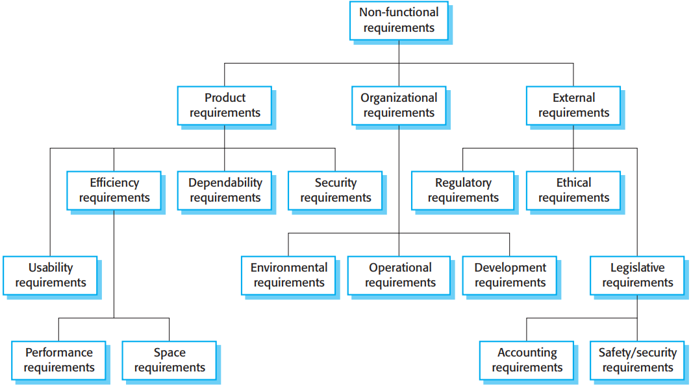

Chap. 4 Requirements engineering
Types of NFR 非功能性需求的类型

Slide 17
Chap. 4 Requirements engineering
NFR classifications 非功能性需求分类
Product requirements: Specify or constrain the runtime behavior of the software. Examples include performance requirements for how fast the system run and how much memory it requires; reliability requirements that set out the acceptable failure rate; security requirements; etc. 产品需求
Organizational requirements: Broad requirements derived from policies and procedures in the customer’s and developer’s organizations. Examples include define how system is used; specify programming language; etc.组织需求
External requirements: covers all requirements derived from factors external to the system and its development process. may include regulatory requirements such as a nuclear safety authority; legislative requirements that must be followed; ethical requirements; etc. 外部需求

Slide 18
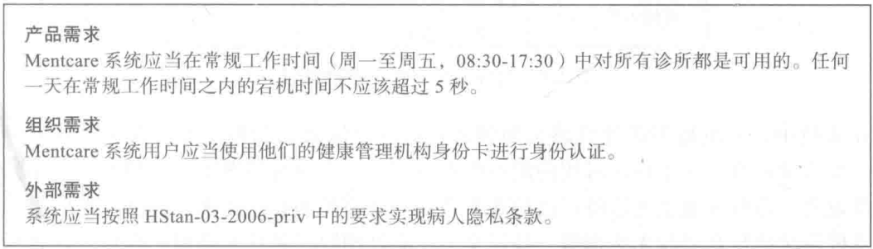
Chap. 4 Requirements engineering
Examples of NFR in the Mentcare system 例子
Product requirement The Mentcare system shall be available to all clinics during normal working hours (Mon–Fri, 0830–17.30). Downtime within normal working hours shall not exceed five seconds in any one day. Organizational requirement Users of the Mentcare system shall authenticate themselves using their health authority identity card. External requirement The system shall implement patient privacy provisions as set out in HStan-03-2006-priv.
• It says nothing about the functionality of the Mentcare system and clearly identifies a constraint that has to be considered.

Slide 19
Chap. 4 Requirements engineering
Problem：Propose requirements as general goals
A common problem with NFR is that stakeholders propose requirements as general goals 问题:NFR表示为目标
Goals set out good intentions but cause problems as they leave scope for interpretation and subsequent dispute. You’d write NFR quantitatively so as to be objectively tested. 表达了好的意图，但留下了解释和争议的空间
e.g. Goal: The system should be easy to use by medical staff and should be organized in such a way that user errors are minimized. (impossible to verify) 目标:无法验证
Verifiable NFR: Medical staff shall be able to use all the system functions after two hours of training. After training, the average number of errors made shall not exceed two per hour. (include software instrumentation to count the errors made by users when testing the system) 可验证NFR

Slide 20
Chap. 4 Requirements engineering
Metrics for specifying nonfunctional requirements
刻画非功能需求的度量
Property | Measure
Speed 速度 | Processed transactions/second User/event response time Screen refresh time
Size 规模 | Mbytes Number of ROM chips
Ease of use 易用 | Training time Number of help frames
Reliability 可靠性 | Mean time to failure Probability of unavailability Rate of failure occurrence Availability
Robustness 鲁棒性 | Time to restart after failure Percentage of events causing failure Probability of data corruption on failure
Portability 可移植性 | Percentage of target dependent statements Number of target systems

Slide 21
Chap. 4 Requirements engineering
4.2 Requirements engineering processes 需求工程过程
Requirements engineering involves three key activities. These are discovering requirements by interacting with stakeholders (elicitation and analysis); converting these requirements into a standard form (specification); and checking that the requirements actually define the system that the customer wants (validation). 涉及三个关键活动：抽取/分析、规格说明、确认
In practice, RE is an iterative activity in which these processes are interleaved. 实际:迭代、交织

Slide 22
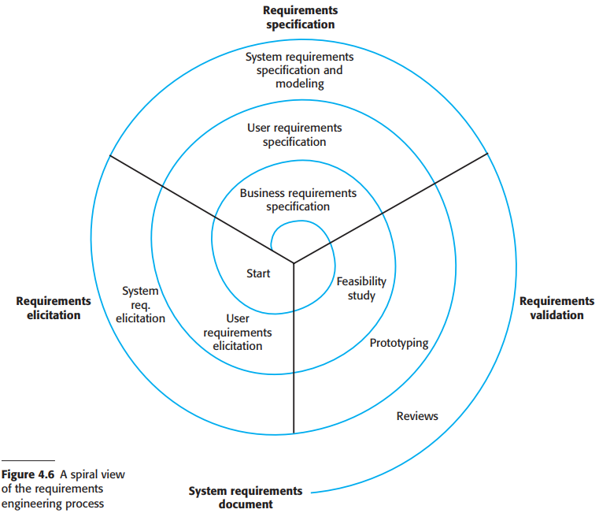
• The output of the RE process is a system requirements document.
• The amount of time and effort devoted to each activity in an iteration depends on the stage of the overall process, the type of system being developed, and the budget that is available.
需求工程过程螺旋视图

Slide 23
Chap. 4 Requirements engineering
4.3 Requirements elicitation
The aims of the requirements elicitation process are to understand the work that stakeholders do and how they might use a new system to help support that work. 目标:理解干系人工作,如何运用新系统
During requirements elicitation, software engineers work with stakeholders to find out about the application domain, work activities, the services and system features that stakeholders want, the required performance of the system, hardware constraints, and so on. 弄清楚：应用领域、工作活动、干系人想要的服务和系统特性、要求的系统性能、硬件约束等

Slide 24
Chap. 4 Requirements engineering
Problems of requirements elicitation 需求抽取中的问题
Stakeholders don’t know what they really want.
Stakeholders express requirements in their own terms that the engineers may not understand.
Different stakeholders may express requirements in different ways, and the engineers have to discover commonalities and conflicts.
Organizational and political factors may influence the system requirements.
The requirements change during the analysis process. New stakeholders may emerge and the business environment may change.

Slide 25
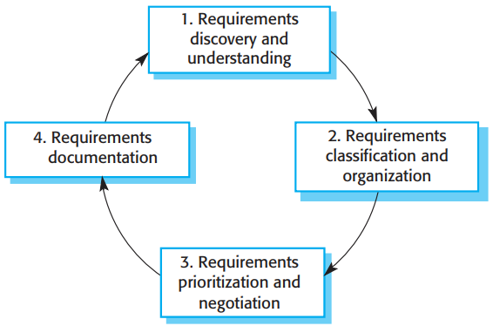
Chap. 4 Requirements engineering
The requirements elicitation and analysis process 需求抽取和分析过程

Slide 26
Chap. 4 Requirements engineering
Process activities 过程活动
Requirements discovery and Understanding
Interacting with stakeholders to discover their requirements. Domain requirements are also discovered at this stage. 需求发现和理解
Requirements classification and organisation
Groups related requirements and organizes them into coherent clusters. 需求分类和组织
Requirements prioritization and negotiation
Prioritizing requirements and resolving requirements conflicts. 需求优先级化和协商
Requirements documentation
Requirements are documented and input into the next round of the spiral. 需求文档化

Slide 27
Chap. 4 Requirements engineering
Requirements elicitation techniques
Involves meeting with stakeholders of different kinds to discover information about the proposed system. 与各种干系人会面,发现系统的信息
There are two fundamental approaches: 两种途径
Interviewing, where you talk to people about what they do. 访谈
Observation or ethnography, where you watch people doing their job to see what artifacts they use, how they use them, and so on. 观察或人种志
You hould use a mix of interviewing and observation to collect information and, from that, derive the requirements. 应混合使用两种途径

Slide 28
Chap. 4 Requirements engineering
Interviewing 访谈
Formal or informal interviews with stakeholders
Puts questions, derive requirements from the answers.
Types of interview 访谈类型
Closed interviews, where the stakeholder answers a predefined set of questions. 封闭式访谈
Open interviews, where there is no predefined agenda. The requirements engineering team explores a range of issues with stakeholders. 开放式访谈
In practice 实践中
Interviews are normally a mixture of both of these;
You may obtain the answer to certain questions, but these usually lead to other issues. Completely open-ended discussions rarely work well.

Slide 29
Chap. 4 Requirements engineering
Problems with interviews
All application specialists use jargon to discuss domain requirements. They normally use words in a precise and subtle way that requirements engineers may misunderstand. 应用专家使用行话，以精确和微妙的方式，需求工程师可能误解
Some domain knowledge is so familiar to stakeholders that they either find it difficult to explain or they think it is so fundamental that it isn’t worth mentioning. 领域知识:或难解释,或过于基本而不值一提

Slide 30
Chap. 4 Requirements engineering
An effective interviewer should: 应怎么做
Be open-minded, avoid preconceived ideas, and willing to listen to stakeholders. If the stakeholder comes up with surprising requirements, then you should be willing to change your mind about the system. 思想开明，避免预设想法，愿意倾听
Prompt the interviewee to get discussions going by using a springboard question or a requirements proposal, or by working together on a prototype system. Saying to people “tell me what you want” is unlikely to result in useful information. They find it much easier to talk in a defined context rather than in general terms. 给受访人提示：使用跳板性问题，或需求建议，或一起讨论原型

Slide 31
Chap. 4 Requirements engineering
Ethnography 人种学调查
It is very important that, during the requirements engineering process, you try to understand the social and organizational issues that affect the use of the system. 需求分析过程中，要考虑社会和组织问题
Ethnography is an observational technique that can be used to understand operational processes and help derive requirements. An analyst immerses himself or herself in the working environment. The day-to-day work is observed, and notes are made of the actual tasks in which participants are involved. 是一种观察技术
The value of ethnography is that it helps discover implicit system requirements that reflect the actual ways that people work. 价值：发现隐含需求

Slide 32
Chap. 4 Requirements engineering
Ethnography is particularly effective for discovering two types of requirements: 人种学调查尤其适合于发现两种需求
Requirements derived from the way in which people actually work, rather than the way in which business process definitions say. In practice, people never follow formal processes. 从实际工作方式，而不是业务过程定义中得出的需求
Requirements derived from cooperation and awareness of other people’s activities. 从与他人合作和对他人活动的了解中得出的需求

Slide 33
Chap. 4 Requirements engineering
Ethnography can be combined with the development of a system prototype. 人种学调查可与系统原型开发相结合
The ethnography informs the development of the prototype so that fewer prototype refinement cycles are required. 人种学调查为原型开发提供信息
Furthermore, the prototyping focuses the ethnography by identifying problems and questions that can then be discussed with the ethnographer. 原型识别问题和疑问，与调查人员讨论，使人种学调查更聚焦

Slide 34

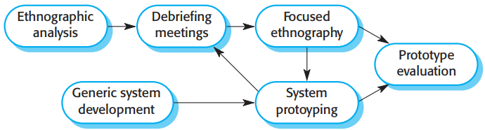
Chap. 4 Requirements engineering
Ethnography and prototyping for requirements analysis 用于需求分析的人种学调查和原型化
• Ethnography is helpful to understand existing systems, but this understanding does not always help with innovation. Innovation is particularly relevant for new product development.
• Ethnographic studies can reveal critical process details that are often missed by other requirements elicitation techniques. However, because of its focus on the enduser, this approach is not effective for discovering broader organizational or domain requirements or for suggestion innovations.

Slide 35
Chap. 4 Requirements engineering
Stories and scenarios 故事和场景
Stories and scenarios are a description of how the system can be used for some particular task. They describe what people do, what information they use and produce, and what systems they may use in this process. 含义：系统如何使用的描述
The difference is in the ways that descriptions are structured and in the level of detail presented. Stories are written as narrative text and present a high-level description of system use; scenarios are usually structured with specific information collected such as inputs and outputs. Stories are effective in setting out the “big picture.” Parts of stories can then be developed in more detail and represented as scenarios. 两者区别:描述的组织方式，呈现的详细程度

Slide 36
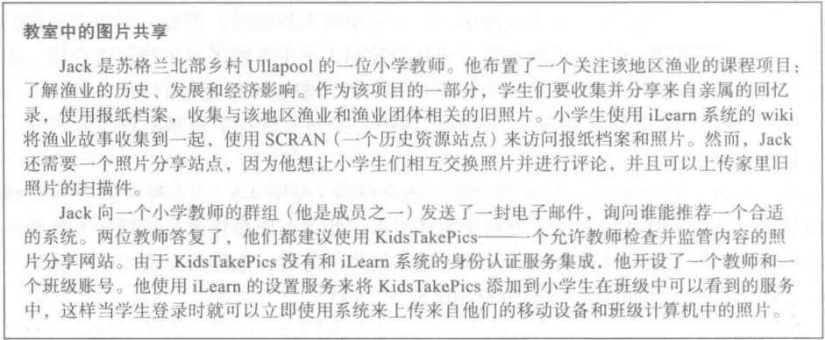
Chap. 4 Requirements engineering
A user story for the iLearn system：Photo sharing in classroom (iLearn) 用户故事实例
Jack is a primary school teacher in Ullapool (a village in northern Scotland). He has decided that a class project should be focused around the fishing industry in the area, looking at the history, development and economic impact of fishing. As part of this, pupils are asked to gather and share reminiscences from relatives, use newspaper archives and collect old photographs related to fishing and fishing communities in the area. Pupils use an iLearn wiki to gather together fishing stories and SCRAN (a history resources site) to access newspaper archives and photographs. However, Jack also needs a photo sharing site as he wants pupils to take and comment on each others’ photos and to upload scans of old photographs that they may have in their families. Jack sends an email to a primary school teachers group, which he is a member of to see if anyone can recommend an appropriate system. Two teachers reply and both suggest that he uses KidsTakePics, a photo sharing site that allows teachers to check and moderate content. As KidsTakePics is not integrated with the iLearn authentication service, he sets up a teacher and a class account. He uses the iLearn setup service to add KidsTakePics to the services seen by the pupils in his class so that when they log in, they can immediately use the system to upload photos from their mobile devices and class computers.

Slide 37
Chap. 4 Requirements engineering
Scenarios 场景
Scenarios are descriptions of example user interaction sessions. It is best to present scenarios in a structured way. A scenario starts with an outline of the interaction. During the elicitation process, details are added to create a complete description of that interaction.含义: 用户交互会话的描述，以结构化方式呈现
Scenarios should include 包括
A description of the starting situation; 开始
A description of the normal flow of events; 事件流
A description of what can go wrong and how resulting problems can be handled; 出什么错，如何解决
Information about other activities meanwhile; 同时的活动
A description of the state when the scenario ends. 结束

Slide 38
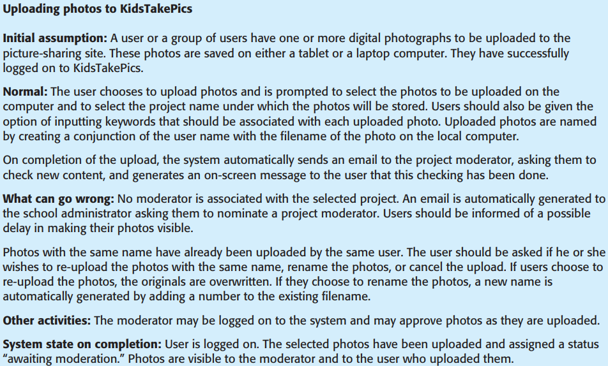

Chap. 4 Requirements engineering
Example of scenario: Uploading photos 场景例子

Slide 39
Chap. 4 Requirements engineering
4.4 Requirements specification 需求规格说明
The process of writing down the user and system requirements in a requirements document. 含义
The user and system requirements should be clear, unambiguous, easy to understand, complete, and consistent. 要求：清晰、无歧义、易理解、完备、一致
User requirements are written in natural language supplemented by appropriate diagrams and tables. System requirements may also be written in natural language, but other notations based on forms, graphical, or mathematical system models can also be used. 用户需求和系统需求的写法

Slide 40
Chap. 4 Requirements engineering
Possible notations for writing system requirements.
Notation | Description
Natural language | The requirements are written using numbered sentences in natural language. Each sentence should express one requirement.
Structured natural language | The requirements are written in natural language on a standard form or template. Each field provides information about an aspect of the requirement.
Graphical notations | Graphical models, supplemented by text annotations, are used to define the functional requirements for the system; UML (unified modeling Language) use case and sequence diagrams are commonly used.
Mathematical specifications | These notations are based on mathematical concepts such as finite-state machines or sets. Although these unambiguous specifications can reduce the ambiguity in a requirements document, most customers don’t understand a formal specification. They cannot check that it represents what they want and are reluctant to accept it as a system contract.

Slide 41
Chap. 4 Requirements engineering
Requirements and design 需求与设计
Ideally, the requirements should only describe the external behavior of the system and its operational constraints, and should not be concerned with how the system be designed. 理想情况：需求不考虑设计
But, it is neither possible nor desirable to exclude all design information, reasons are: 实际不能排除设计信息
You may have to design an initial architecture of the system to help structure the requirements specification; 要初始架构
Systems must interoperate with existing systems, which constrain the design and impose requirements on the new system; 要与现有系统交互,限制了设计,对新系统施加了需求
The use of a specific architecture to satisfy non-functional requirements may be necessary. 使用特定架构来满足非功能需求

Slide 42
Chap. 4 Requirements engineering
Natural language specification 自然语言规格说明
Natural language is expressive, intuitive, and universal; 自然语言：表达能力强、直观、通用
It is also potentially vague and ambiguous, and its interpretation depends on the background of the reader. 也具有潜在的模糊性和二义性
Natural language will continue to be the most widely used way of specifying system and software requirements. 将继续作为刻画系统和软件需求的最广泛使用的方式

Slide 43
Chap. 4 Requirements engineering
Guidelines for writing requirements 需求写作指南
Invent a standard format and use it for all requirements. 发明一种标准的格式
Use language consistently to distinguish between mandatory and desirable requirements. Mandatory requirements are usually written using “shall.” Desirable requirements are written using “should.” 用语言一致性地区分：强制需求 vs 期望需求
Use text highlighting (bold, italic, or color) to pick out key parts of the requirement. 突出关键部分
Avoid the use of jargon, abbreviations, and acronyms. 避免使用行话、缩写、首字母缩略词
Whenever possible, should associate a rationale with each user requirement. 为用户需求附加原理

Slide 44
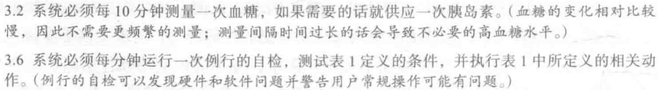
Chap. 4 Requirements engineering
Example requirements for the insulin pump software system 例子
3.2 The system shall measure the blood sugar and deliver insulin, if required, every 10 minutes. (Changes in blood sugar are relatively slow, so more frequent measurement is unnecessary; less frequent measurement could lead to unnecessarily high sugar levels.) 3.6 The system shall run a self-test routine every minute with the conditions to be tested and the associated actions defined in Table 1. (A self-test routine can discover hardware and software problems and alert the user to the fact the normal operation may be impossible.)

Slide 45
Chap. 4 Requirements engineering
Structured specifications 结构化规格说明
A way of writing system requirements where requirements are written in a standard way rather than free-form text. 需求写成标准方式而不是自由文本
It maintains most of the expressiveness and understandability of natural language but ensures that some uniformity is imposed on the specification. 保持了表达能力和可理解性,但确保了统一性
Structured language notations use templates to specify system requirements. The specification may use programming language constructs to show alternatives and iteration, and may highlight key elements using shading or different fonts. 使用模版刻画系统需求

Slide 46
Chap. 4 Requirements engineering
Form-based specifications 基于表单的规格说明
When a standard format is used for specifying requirements, information included: 包含的信息
A description of the function or entity being specified;
A description of its inputs and the origin of these inputs.
A description of its outputs and where they go to.
Information about the information needed for the computation or other entities in the system that are required (the “requires” part).
A description of the action to be taken.
If a function is used, a precondition (setting out what must be true before the function) is called, and a postcondition (specifying what is true after the function) is called.
A description of the side effects (if any) of the operation.

Slide 47
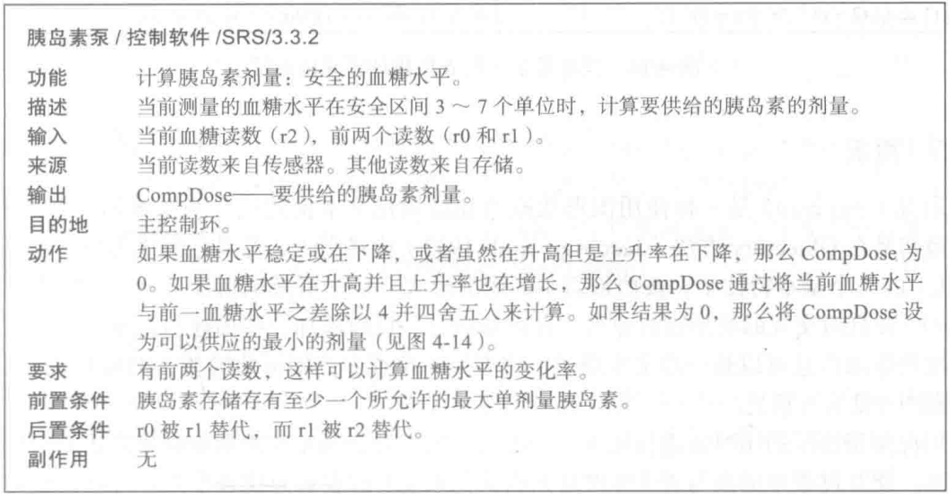
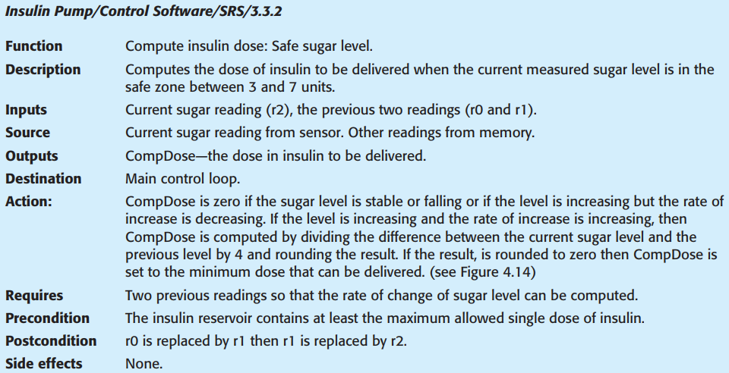
Chap. 4 Requirements engineering
A structured specification of a requirement for an insulin pump - A form-based specification 结构化规格说明实例

Slide 48
Chap. 4 Requirements engineering
Tabular specification 表格化规格说明
Tables are particularly useful when there are a number of possible alternative situations and you need to describe the actions to be taken for each of these. 适用于有多种可能的情况，要描述每种情况下的动作
The insulin pump bases its computations of the insulin requirement on the rate of change of blood sugar levels.
The rates of change are computed using the current and previous readings.
Figure 4.14 is a tabular description of how the rate of change of blood sugar is used to calculate the amount of insulin to be delivered.

Slide 49
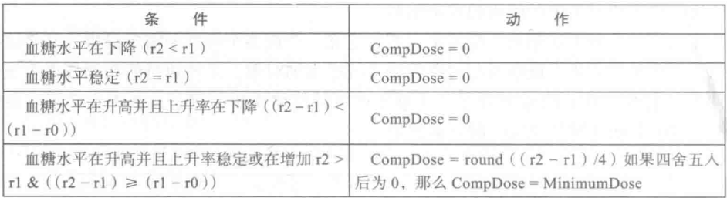
Chap. 4 Requirements engineering
Tabular specification of computation for an insulin pump 例子
Condition | Action
Sugar level falling (r2 < r1) | CompDose = 0
Sugar level stable (r2 = r1) | CompDose = 0
Sugar level increasing and rate of increase decreasing ((r2 – r1) < (r1 – r0)) | CompDose = 0
Sugar level increasing and rate of increase stable or increasing ((r2 – r1) ≥ (r1 – r0)) | CompDose = round ((r2 – r1)/4) If rounded result = 0 then CompDose = MinimumDose

Slide 50
Chap. 4 Requirements engineering
Use cases 用例
Use cases are a way of describing interactions between users and a system using a graphical model and structured text. 描述用户与系统交互的方式
They have become a fundamental feature of the Unified Modeling Language (UML). 已成为UML的特征
The set of use cases represents all of the possible interactions in the system requirements. 表示所有交互
Actors in the process, who may be human or other systems, are represented as stick figures. 参与者
Each class of interaction is represented as a named ellipse. Lines link the actors with the interaction. Optionally, arrowheads may be added to lines to show how the interaction is initiated. 符号表示

Slide 51
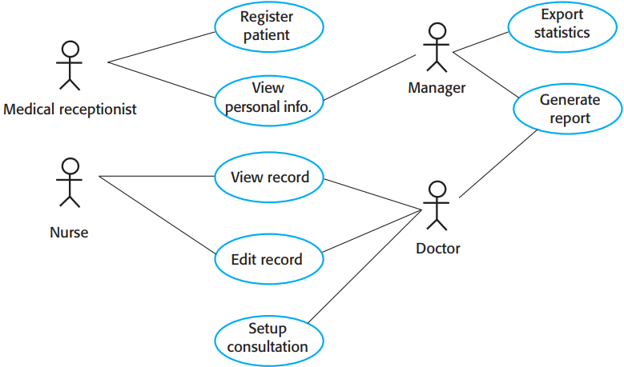
Chap. 4 Requirements engineering
Use cases for the Mentcare system 用例的例子
* Each use case should be documented with a textual description.
* A brief description of the Setup Consultation:
Setup consultation allows two or more doctors, working in different offices, to view the same patient record at the same time. One doctor initiates the consultation by choosing the people involved from a dropdown menu of doctors who are online. The patient record is then displayed on their screens, but only the initiating doctor can edit the record. In addition, a text chat window is created to help coordinate actions. It is assumed that a phone call for voice communication can be separately arranged.

Slide 52
Chap. 4 Requirements engineering
Software requirements document 软件需求文档
The software requirements document (also called the software requirements specification) is an official statement of what the system developers should implement. 系统开发者要实现什么的官方陈述
It may include both the user requirements for a system and a detailed specification of the system requirements. 包括用户需求和系统需求详细规格说明
Requirements documents are essential when systems are outsourced, when different teams develop different parts of the system, and when a detailed analysis of the requirements is mandatory. 有时是必需的
In other circumstances, such as software product or business system development, a detailed requirements document may not be needed. 有时可以不需要

Slide 53
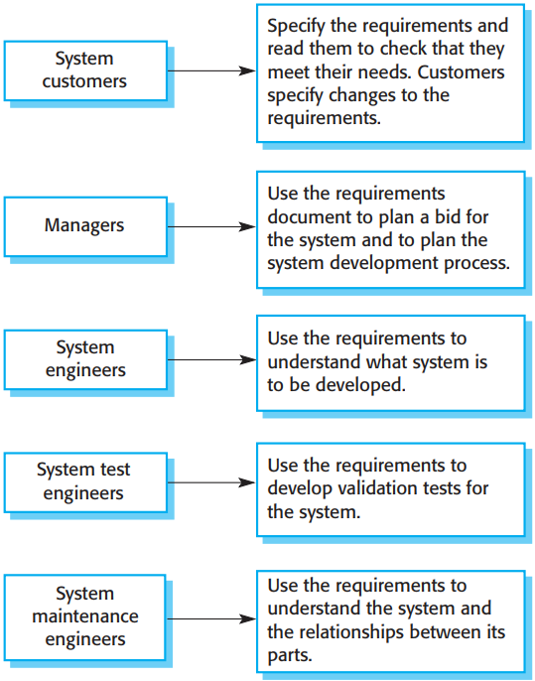
Users of requirements document 需求文档的用户
* The diversity of users means that the requirements document has to be a compromise.
* It has to describe the requirements for customers, define the requirements in precise detail for developers and testers, as well as include information about future system evolution.
* Information on anticipated changes helps system designers to avoid restrictive design decisions and maintenance engineers to adapt the system to new requirements.

Slide 54
Chap. 4 Requirements engineering
Requirements document variability 需求文档变化性
The level of detail in a requirements document depends on system type and the development process. 需求文档的详细程度取决于系统类型和开发过程
Critical systems need detailed requirements because safety and security have to be analyzed in detail to find possible requirements errors. 关键系统:需要详细需求
When the system is to be developed by a separate company, the system specifications need to be detailed and precise. 系统由不同公司开发:系统规格要详细和精确
If an in-house, iterative development process is used, the requirements document can be less detailed. Details can be added to the requirements and ambiguities resolved during development of the system. 内部迭代开发过程：需求文档可不太详细，在开发过程中加入细节和消除模糊性

Slide 55
Chap. 4 Requirements engineering
The structure of a requirements document (IEEE 1998 )
Chapter | Description
Preface前言 | This defines the expected readership of the document and describe its version history, including a rationale for the creation of a new version and a summary of the changes made in each version.
Introduction引言 | This describes the need for the system. It should briefly describe the system’s functions and explain how it will work with other systems. It should also describe how the system fits into the overall business or strategic objectives of the organization commissioning the software.
Glossary 词汇表 | This defines the technical terms used in the document. You should not make assumptions about the experience or expertise of the reader.
User requirements definition 用户需求定义 | Here, you describe the services provided for the user. The nonfunctional system requirements should also be described in this section. This description may use natural language, diagrams, or other notations that are understandable to customers. Product and process standards that must be followed should be specified.
System architecture系统架构 | This chapter should present a high-level overview of the anticipated system architecture, showing the distribution of functions across system modules. Reused architectural components should be highlighted.

Slide 56
Chap. 4 Requirements engineering
The structure of a requirements document (IEEE 1998 )
Chapter | Description
System requirements specification系统需求规格说明 | This describes the functional and nonfunctional requirements in more detail. If necessary, further detail may also be added to the nonfunctional requirements. Interfaces to other systems may be defined.
System models系统模型 | This chapter includes graphical system models showing the relationships between the system components and the system and its environment.
System evolution 系统演化 | This describes the fundamental assumptions on which the system is based, and any anticipated changes due to hardware evolution, changing user needs, and so on. This section is useful for system designers as it may help them avoid design decisions that would constrain likely future changes to the system.
Appendices附录 | These provide detailed, specific information that is related to the application being developed; for example, hardware and database descriptions.
Index 索引 | Several indexes to the document may be included. As well as a normal alphabetic index, there may be an index of diagrams, an index of functions, and so on.

Slide 57
Chap. 4 Requirements engineering
4.5 Requirements validation 需求确认
Requirements validation is the process of checking that requirements define the system that the customer really wants. 含义:检查需求是否定义客户所需
It is critically important because errors in a requirements document can lead to extensive rework costs when these problems are discovered during development or after the system is in service. The cost of fixing a requirements problem by making a system change is usually much greater than repairing design or coding errors. A change to the requirements usually means that the system design and implementation must also be changed. Furthermore, the system must then be retested. 至关重要,需求错误导致返工

Slide 58
Chap. 4 Requirements engineering
Types of requirements checking 需求检查类型
Validity: The requirements reflect the real needs of system users. 正确性
Consistency: Requirements in the document should not conflict. 一致性
Completeness: The requirements document should include requirements that define all functions and the constraints intended by the system user. 完整性
Realism: The requirements should be checked to ensure that they can be implemented within the proposed budget and schedule. 现实性
Verifiability: To reduce the potential dispute between customer and contractor, system requirements should always be written so that they are verifiable. 可验证性

Slide 59
Chap. 4 Requirements engineering
Requirements validation techniques 需求确认技术
Requirements reviews 需求评审
The requirements are analyzed systematically by a team of reviewers who check for errors and inconsistencies.
Prototyping 原型
Developing an executable model of a system and using this with end-users and customers to see if it meets their needs and expectations.
Test-case generation 测试用例生成
Developing tests from the user requirements before any code is written is an integral part of test-driven development.

Slide 60
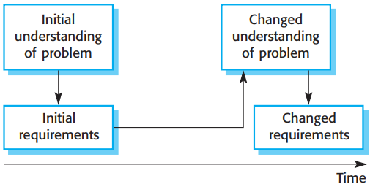
Chap. 4 Requirements engineering
4.6 Requirements change 需求变更
During the software development process, the stakeholders’ understanding of the problem is constantly changing. 理解在变
The system requirements must then evolve to reflect this changed problem understanding. 需求必须演化来反映理解的变化

Slide 61
Chap. 4 Requirements engineering
Requirements changes due to business environment changes: 因业务环境变化引起的需求变更
The business and technical environment always changes after installation. New hardware may be introduced and existing hardware updated. It may be necessary to interface with other systems. Business priorities may change, new regulations may be introduced. 业务和技术环境总在变
The people who pay and the users of that system are rarely the same people. System customers impose requirements because of organizational and budgetary constraints. These may conflict with end-user requirements, and, after delivery, new features may have to be added for user support if the system is to meet its goals. 付钱者和使用者是不同的人
Large systems have a diverse stakeholder community, with stakeholders having different requirements. Their priorities may be conflicting or contradictory. The final system requirements are inevitably a compromise. With experience, the balance of support given to different stakeholders has to be changed and the requirements re-prioritized. 各色干系人的需求优先级可能冲突和矛盾

Slide 62
Chap. 4 Requirements engineering
Requirements management 需求管理
You need to keep track of individual requirements and maintain links between dependent requirements so that you can assess the impact of requirements changes. 需要跟踪各需求,保持需求之间依赖关系链接
Therefore need a formal process for making change proposals and linking these to system requirements. 因此需要一个正式过程来提出变更建议并与系统需求关联
This process of “requirements management” should start as soon as a draft version of the requirements document is available. 需求管理在有了需求文档草稿后就应开始
Agile development processes have been designed to cope with requirements change. So a change doesn’t go through a formal change management process. 敏捷开发的变更不经过正式变更管理过程

Slide 63
Chap. 4 Requirements engineering
Requirements management planning 需求管理计划
Establishing how a set of evolving requirements will be managed. 确立:如何管理一组演化的需求
Issues during the planning stage: 计划阶段中的问题
Requirements identification: Each requirement must be uniquely identified so that it can be cross-referenced with other requirements. 需求标识
A change management process: The set of activities that assess the impact and cost of changes. 变更管理过程
Traceability policies: The policies define the relationships between each requirement and between the requirements and the system design that should be recorded. 跟踪原则
Tool support: Tools that may be used range from specialist requirements management systems to spreadsheets and simple database systems. 工具支持

Slide 64
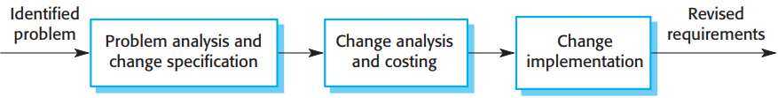
Chap. 4 Requirements engineering
Requirements change management 需求变更管理
Change management is essential because you need to decide if the benefits of implementing new requirements are justified by the costs of implementation. 重要,决定了实现新需求是否成本合算
The advantage of using a formal process for change management is that all change proposals are treated consistently and changes to the requirements document are made in a controlled way. 优势：变更建议一致处理，需求文档变更受控

Slide 65
Chap. 4 Requirements engineering
Requirements change management 需求变更管理
Change management process, 3 principal stages: 三阶段
Problem analysis and change specification: The problem or the change proposal is analyzed to check that it is valid. This analysis is fed back to the change requestor who may respond with a more specific requirements change proposal, or decide to withdraw the request. 问题分析和变更规格说明
Change analysis and costing: The effect of the proposed change is assessed using traceability information and general knowledge of the system requirements. The cost of making the change is estimated. Once this analysis is completed, a decision is made as to whether or not to proceed with the requirements change. 变更分析和成本考量
Change implementation: The requirements document and, where necessary, the system design and implementation, are modified. You should organize the requirements document to avoid extensive rewriting or reorganization. 变更实现

Slide 66
Chap. 4 Requirements engineering
Key points
Requirements for a software system set out what the system should do and define constraints on its operation and implementation.
Functional requirements are statements of the services that the system must provide or are descriptions of how some computations must be carried out.
Non-functional requirements often constrain the system being developed and the development process being used.
They often relate to the emergent properties of the system and therefore apply to the system as a whole.

Slide 67
Chap. 4 Requirements engineering
Key points
The requirements engineering process is an iterative process that includes requirements elicitation, specification and validation.
Requirements elicitation is an iterative process that can be represented as a spiral of activities – requirements discovery, requirements classification and organization, requirements negotiation and requirements documentation.
You can use a range of techniques for requirements elicitation including interviews and ethnography. User stories and scenarios may be used to facilitate discussions.

Slide 68
Chap. 4 Requirements engineering
Key points
Requirements specification is the process of formally documenting the user and system requirements and creating a software requirements document.
The software requirements document is an agreed statement of the system requirements. It should be organized so that both system customers and software developers can use it.

Slide 69
Chap. 4 Requirements engineering
Key points
Requirements validation is the process of checking the requirements for validity, consistency, completeness, realism and verifiability.
Business, organizational and technical changes inevitably lead to changes to the requirements for a software system. Requirements management is the process of managing and controlling these changes.

